Slide 1
ACCY577 Machine Learning for Accounting
Module 5: Model Optimization
Linden Lu

Slide 2
Lesson 1: Feature Selection
Key benefits
Reduces Overfitting
Improves Accuracy
Reduces Training Time
Improves Interpretability

Slide 3
Feature selection algorithms
Filter methods
Wrapper methods
Embedded methods

Slide 4
Filter Methods
Variance Threshold
Rank features by variance
Feature Scaling is necessary
Doesn't use target feature
Univariate Techniques
Rate features individually
Relationship between individual feature and target feature

Slide 5
Wrapper methods
Recursive Feature Extraction

Slide 6
Embedded Methods
Rank features during training
Model dependent
Decision Tree
Random Forest

Slide 7
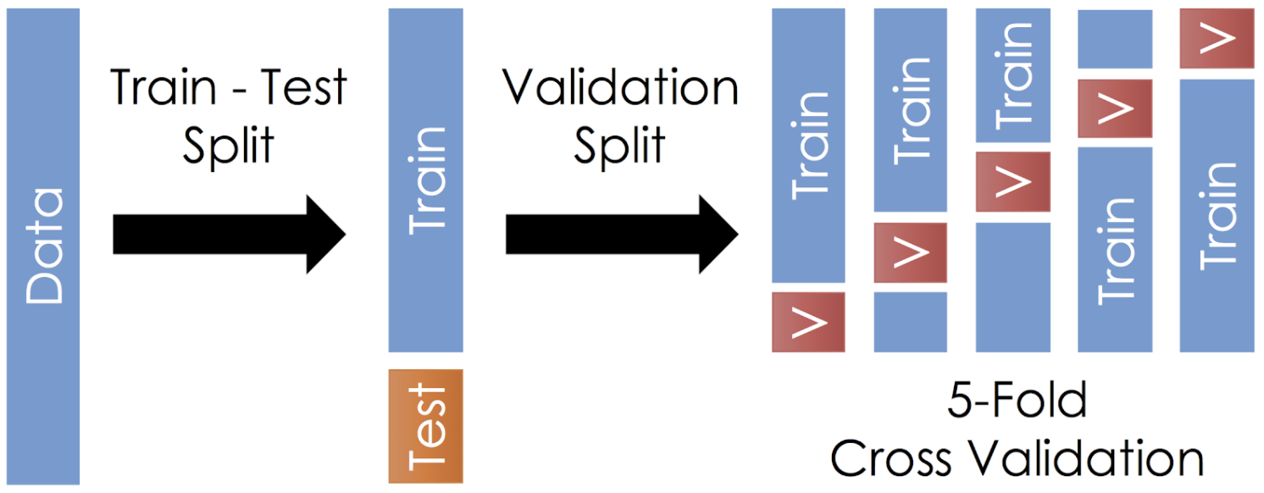
Lesson 2: Introduction to Cross Validation
Train Test Split vs. Cross Validation

Slide 8
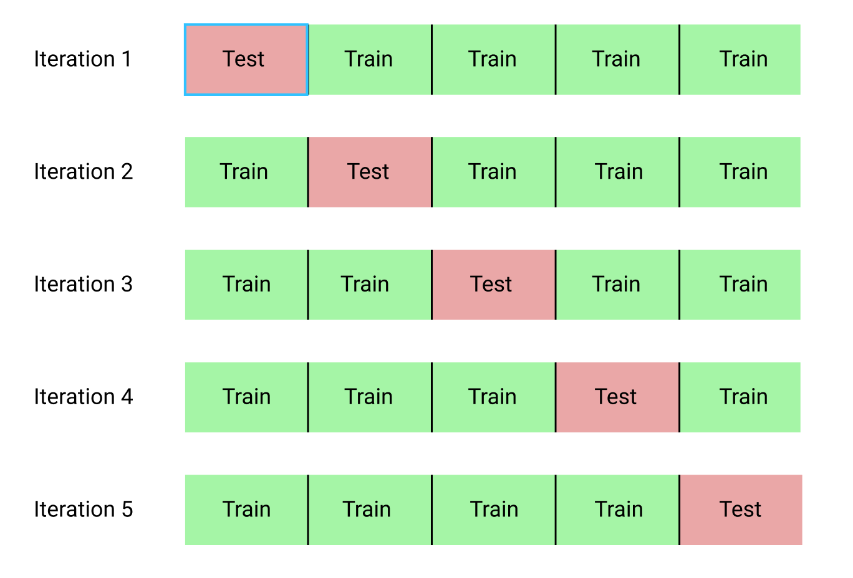
KFold

Slide 9
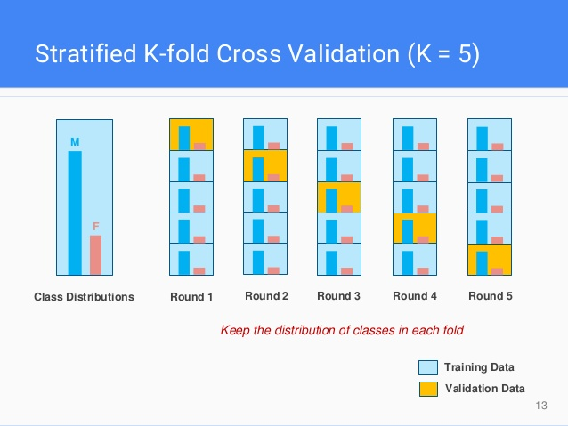
Stratified KFold

Slide 10
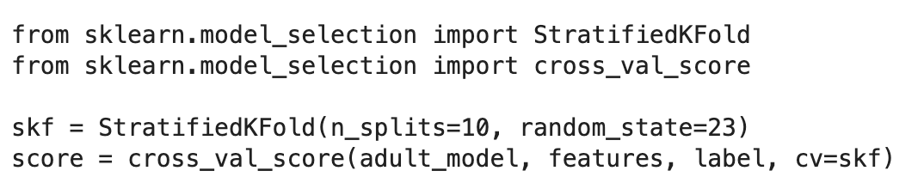
Evaluate Model with Cross-Validation

Slide 11

Custom Scoring

Slide 12
Lesson 3: Model Selection with Cross Validation
Grid Search
Random Grid Search

Slide 13
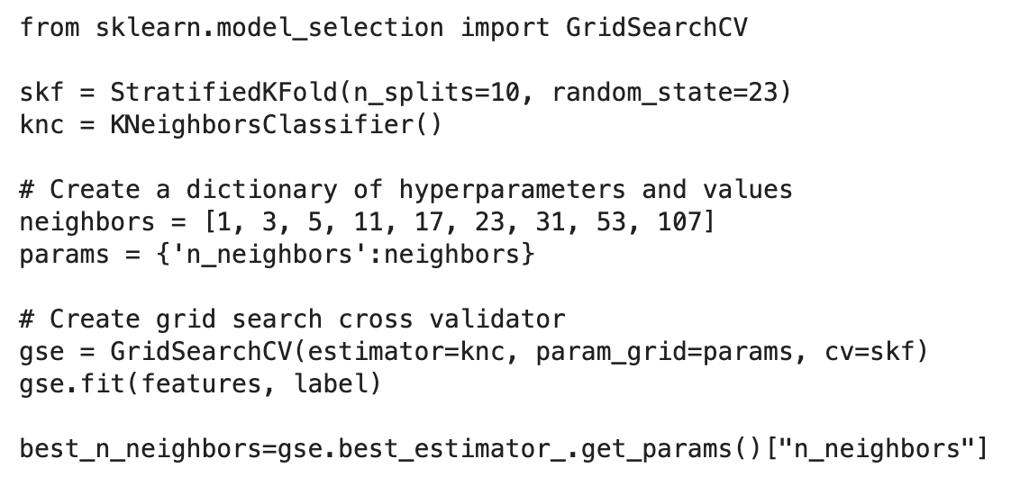
Grid Search

Slide 14
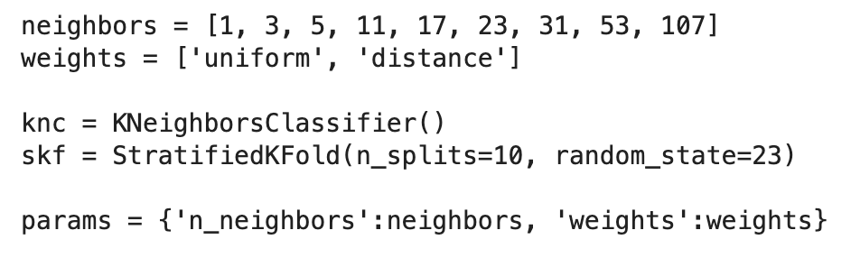
Multi-dimensional Grid Search

Slide 15
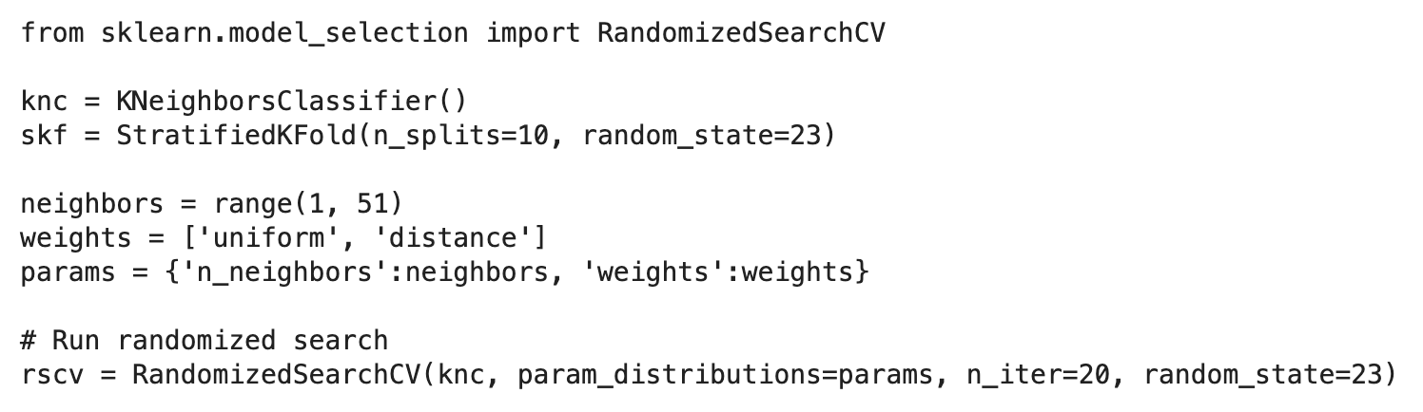
Randomized Grid Search

